Slide 1

Multi-class classification
Softmax regression
deeplearning.ai

Slide 2
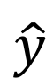
Recognizing cats, dogs, and baby chicks
3
1
2
0
3
2
0
1
X
$$\hat{y}$$

Slide 3
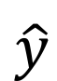
Softmax layer
X
$$\hat{y}$$

Slide 4
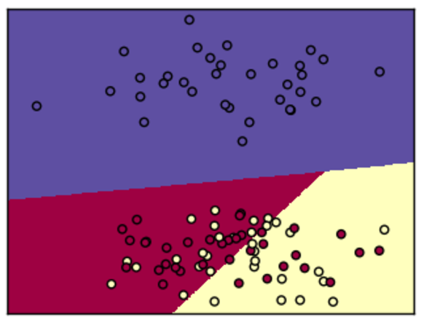
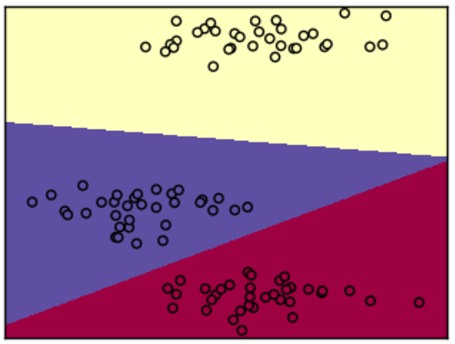
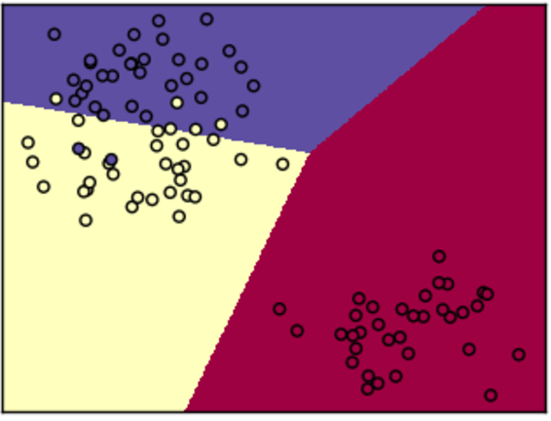
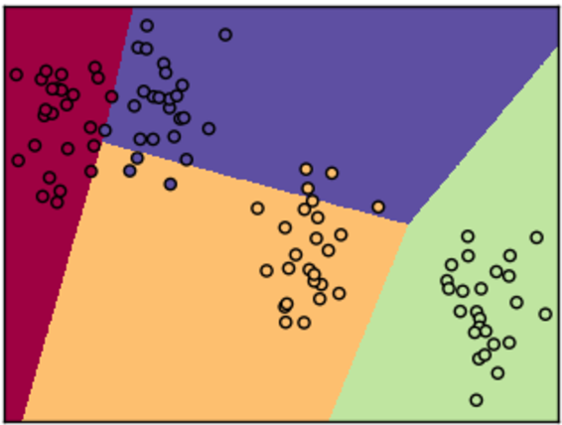
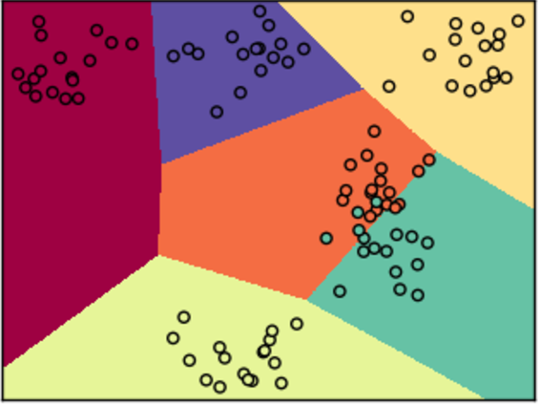
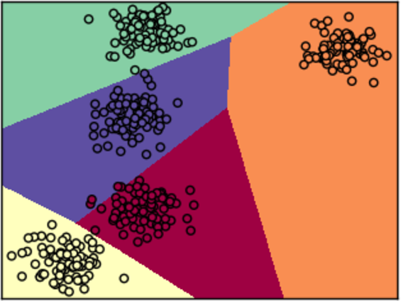
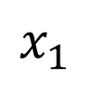
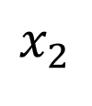
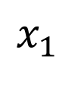
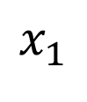
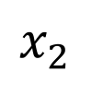
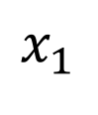
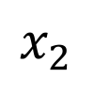
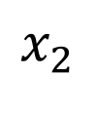
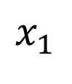
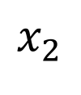
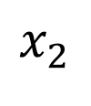
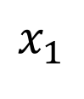
Softmax examples
$$x_{2}$$
$$x_{2}$$
$$x_{2}$$
$$x_{1}$$
$$x_{1}$$
$$x_{1}$$
$$x_{2}$$
$$x_{2}$$
$$x_{2}$$
$$x_{1}$$
$$x_{1}$$
$$x_{1}$$

Slide 5
Multi-class classification
Trying a softmax
classifier
deeplearning.ai

Slide 6
Understanding softmax

Slide 7
Loss function

Slide 8
Summary of softmax classifier
X
$$\hat{y}$$

